Slide 1
A Simple Linear Regression Analysis on Food Servers’ Tips in Restaurants

Slide 2
A Presentation By Lilian Nwafor A Data Analyst
21th OF NOVEMBER, 2022

Slide 3
Problem Statement
The total bill given to a customer is one the factors influencing food servers’ tips. What determines the amount of tip given by a customer to the food server?
DATA COLLECTION PROCESS The dataset for this project was gotten from Kaggle platform through the following link: https://www.kaggle.com/datasets/tasneemabdulrahim/tips-dataset
MY APPROACH I analyze the dataset using the Pandas Library. I visualize the dataset for a relation between the response and target variable using the Seaborn Library. OLS and qqplot from Statsmodels was used for model extraction and prediction.

Slide 4
DATASET DESCRIPTION
Tip giving is not a necessity but it is crucial act of humanity considering that most servers are low income earners.
The dataset for this project has a total of 7 columns and 244 rows.

Slide 5
EXPLORATORY DATA ANALYSIS
The dataset was thoroughly inspected and there was no duplicate or missing values in our dataset.
From the descriptive statistics performed, It was observed that there is a strong positive correlation between the total bills and tips derived.
The dataset contained 24 rows and 12 columns.
Using the seaborn library, next slide shows the visualization of the dependent and independent variables.

Slide 6
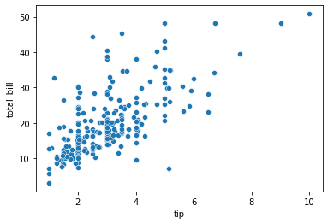
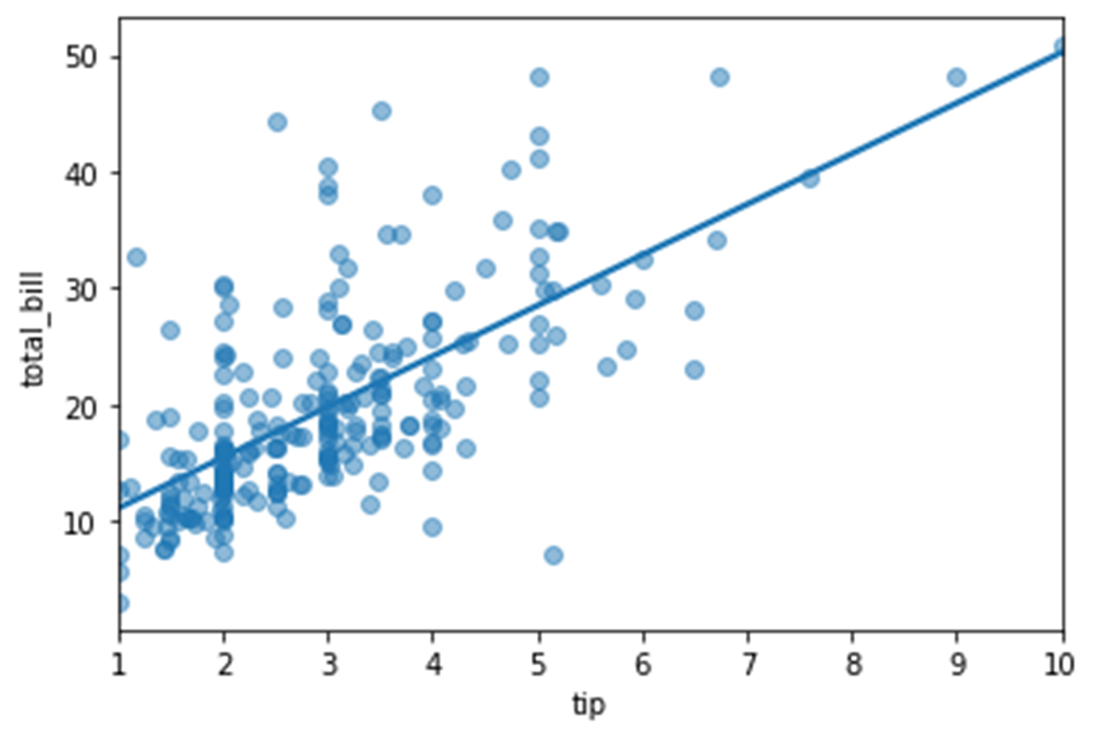
SCATTER PLOT AND REGPLOT
The plot A is a scatter plot that shows there is a positive relationship between the tip and total bill of a customer. Plot B, regplot displayed a clearer view of the relationship with the line.

Slide 7
FITTING THE MODEL
The result of the fitted model with parameter shows that the model has an intercept of 6.750284, which means that on average, a bill of a customer totalling $6.750284 has a zero tip.
The model also has a tip coefficient of 4.347714 which means that increment by 1 on the amount of tip given will result to an expected increase on the total bill by 4.347714.

Slide 8
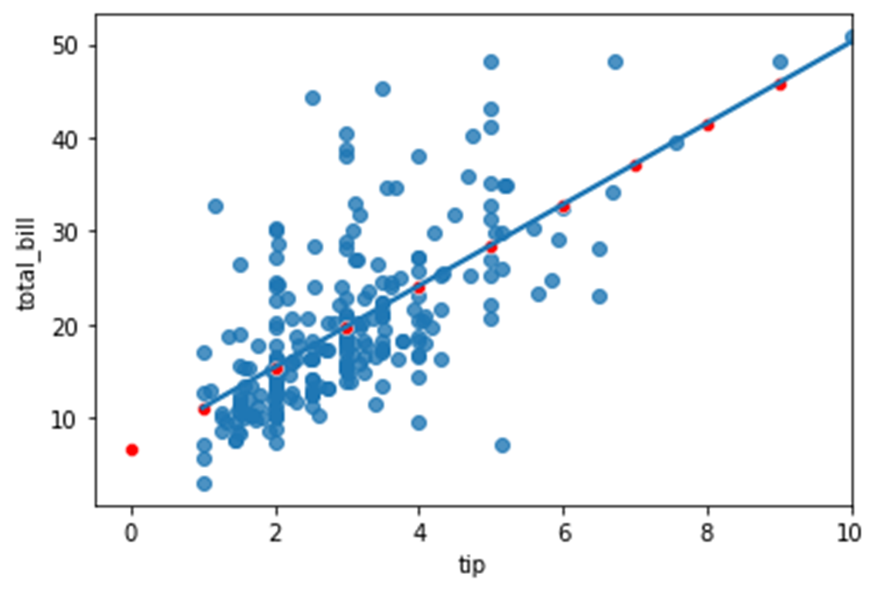
Tips | Total Bill
0 | 6.750284
1 | 11.097998
2 | 15.445712
3 | 19.793426
4 | 24.141141
5 | 28.488855
6 | 32.836569
7 | 37.184283
8 | 41.531997
9 | 45.879712
PREDICTING THE EXPLANATORY VARIABLE
The table show that with $4 tip, the total bill of the customer will be $24.1411141. Also, a tip od $8 means a total bill of $41.531997

Slide 9
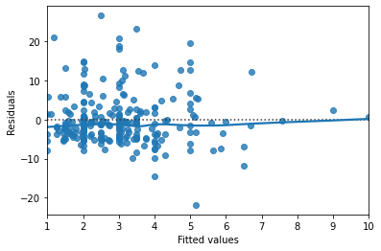
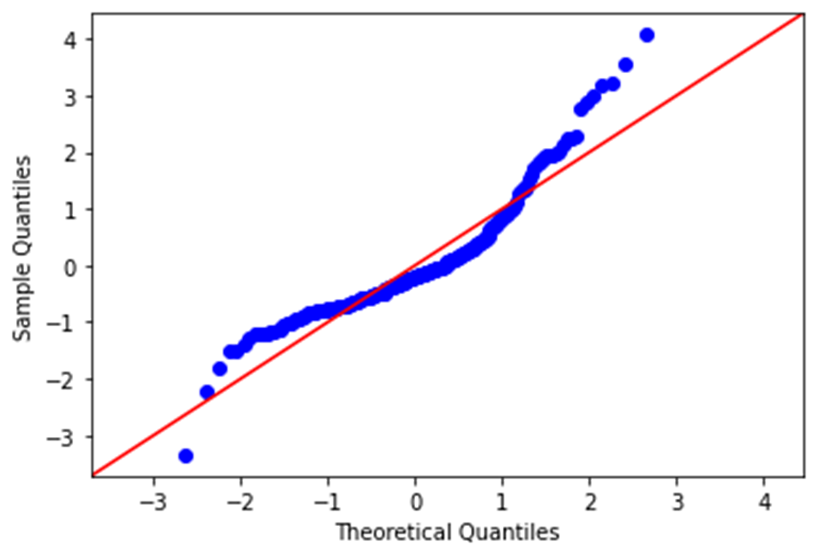
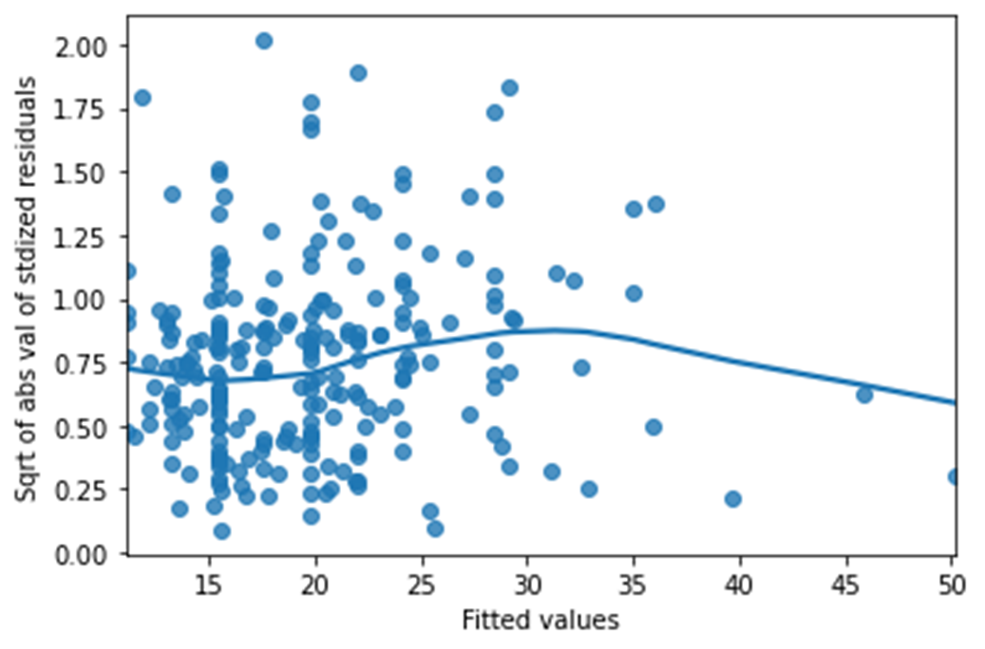
DRAWING DIAGNOSTIC PLOTS
RESIDUALS VS. FITTED VALUES
THE Q-Q PLOT OF THE RESIDUALS
THE SCALE LOCATION PLOT
The above (three diagnostic) plots help to check the quality of the models. RESIDUALS VS. FITTED VALUES Residuals vs fitted, though not good making prediction but better in visualizing trends. The residuals met the assumption that are normally distributed with mean 0 and the trend line closely follow the y = 0 line on the plot. THE Q-Q PLOT OF THE RESIDUALS The point is normally distributed. THE SCALE LOCATION PLOT This shows that the size of the residual gets smaller.

Slide 10
THANK YOU

